Slide 1
TOWARD A NEW CHEMICAL
MECHANISM IN WRF/CHEM
FOR DIRECT AND
INDIRECT AEROSOL EFFECTS
PAOLO TUCCELLA, GEORG GRELL,
STUART MCKEEN,
RAVAN AHMADOV, GABRIELE CURCI,
NICO CIMINI, GUIDO VISCONTI

Slide 2
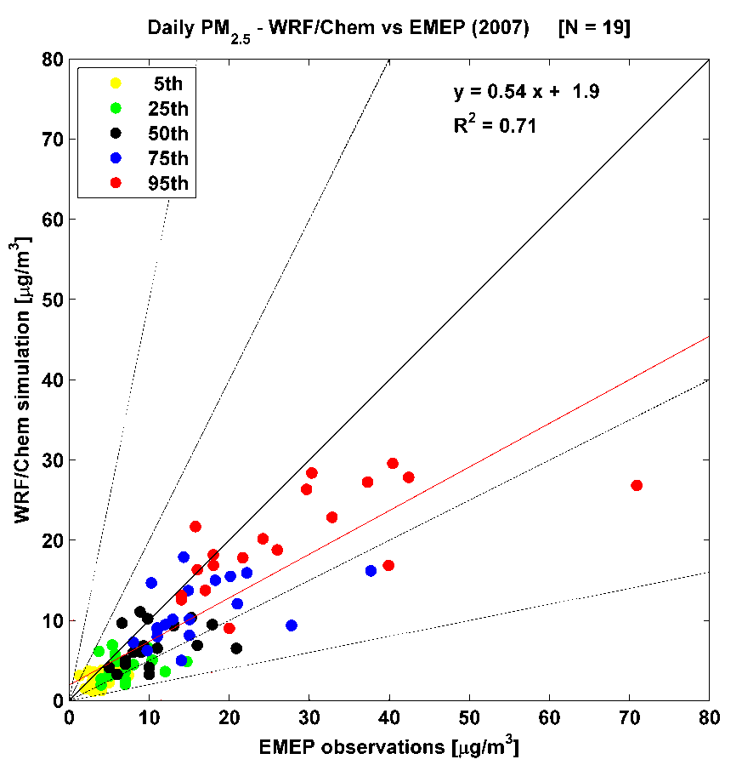
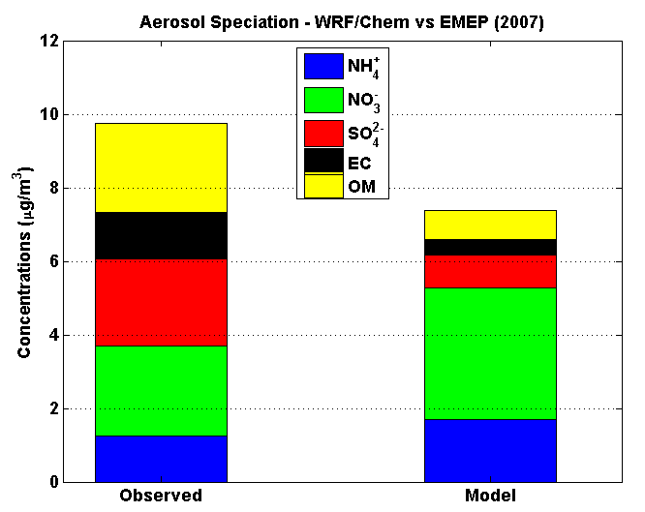
WHY A NEW CHEMICAL MECHANISM?
A FOCUS ON THE CARBONACEUS AEROSOLS
PM2.5 is underestimated by a factor 2 using the “classic” configuration (MADE/SORGAM aerosol mechanism)
The underestimation is due to the carbonaceous aerosols. Organic matter (-76%)
[Tuccella et al., JGR, 2012]

Slide 3
THE RACM/MADE/SOA-VBS MECHANISM
The gas phase chemistry is simulated with the Ragional Atmospheric Chemistry Model (RACM) updated to include the sesquiterpenes.
Particle parameterization: MADE.
The production of SOA is based on the Volatile Basis Set approch.
The new scheme contains 4 volatile bins for each SOA class (16 SOA and 8 OCVs).
The SOAs are formed by anthropogenic and biogenic sources.
[Ahmadov et al., JGR, 2012]

Slide 4
WRF/CHEM SETUP
Period: May-June 2003.
Resolution: 30 Km, 28 vertical levels (p_top = 50 hPa, 15-16 Km).
Initial and boundary meteorological conditions: NCEP analysis (every 6 hours).
Initial and boundary chemical conditions: climatological profiles.
PHYSICAL PROCESS | WRF/CHEM OPTION
MICROPHYSIC | MORRISON
LONGWAWE | RRTM
SHORTWAWE | GODDARD
SURFACE LAYER | MONIN-OBUKHOV
LAND SURFACE | NOAH LSM
PBL | MYNN LEVEL 2.5 PBL
CUMULUS CLOUDS | G3
PHOTOLYSIS | MADRONICH
BIOGENIC EMISSIONS | MEGAN
WET DEPOSITION | INCLUDED
FEEDBACK | NO
Anthropogenic Emissions:
EMEP and Laboratoire d’Aerologie for OC/EC

Slide 5
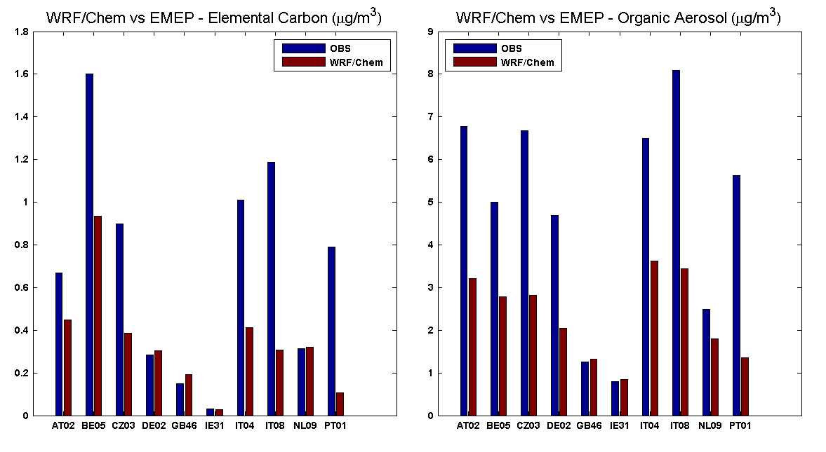
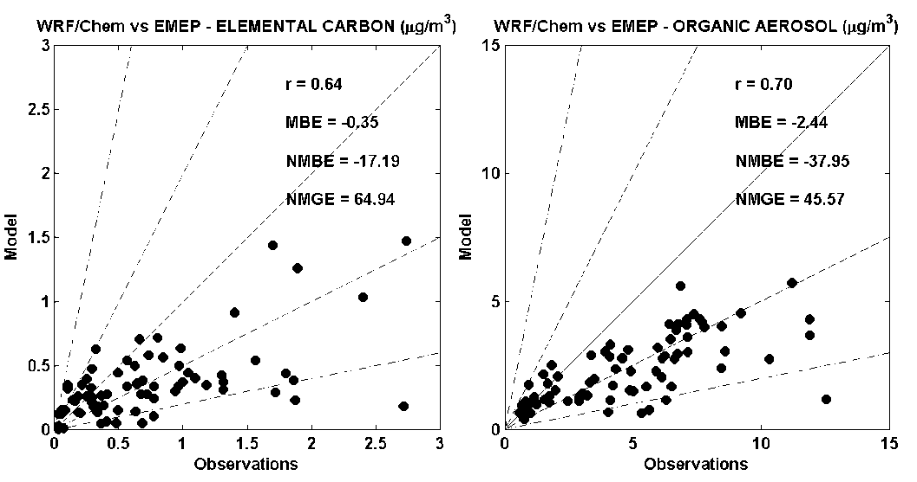
WRF/CHEM vs EC/OC EMEP DATA (2002-2003 CAMPAIGN)
Daily sample/week
Obeservd OA = 1.6 OC
EC: r=0.64 bias=-17%
OA: r=0.70 bias=-38%

Slide 6
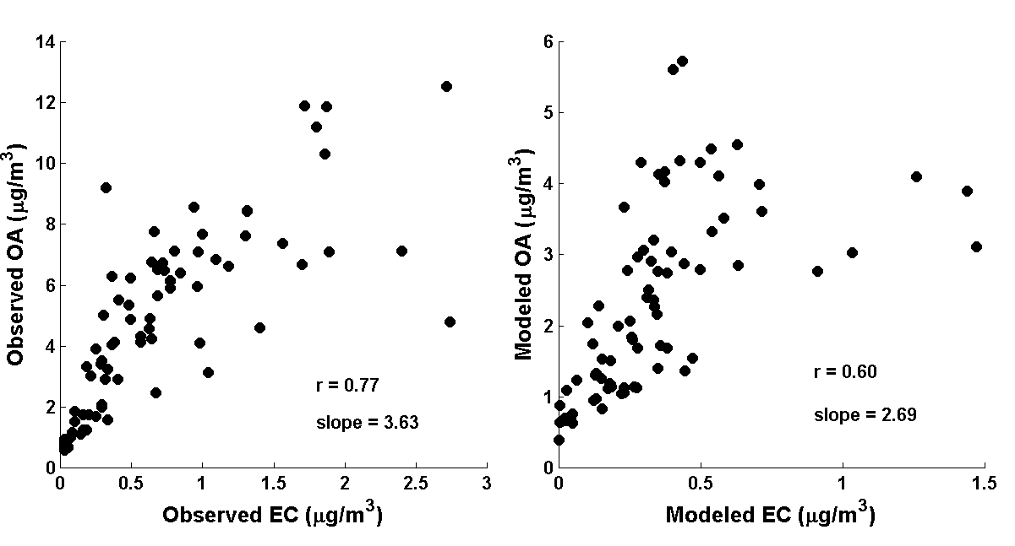
WRF/CHEM vs EC/OC EMEP DATA: OA:EC RATIO
OBSERVED
MODELED
WRF/Chem underestimates the observed
correlation and slope of OA:EC ratio

Slide 7
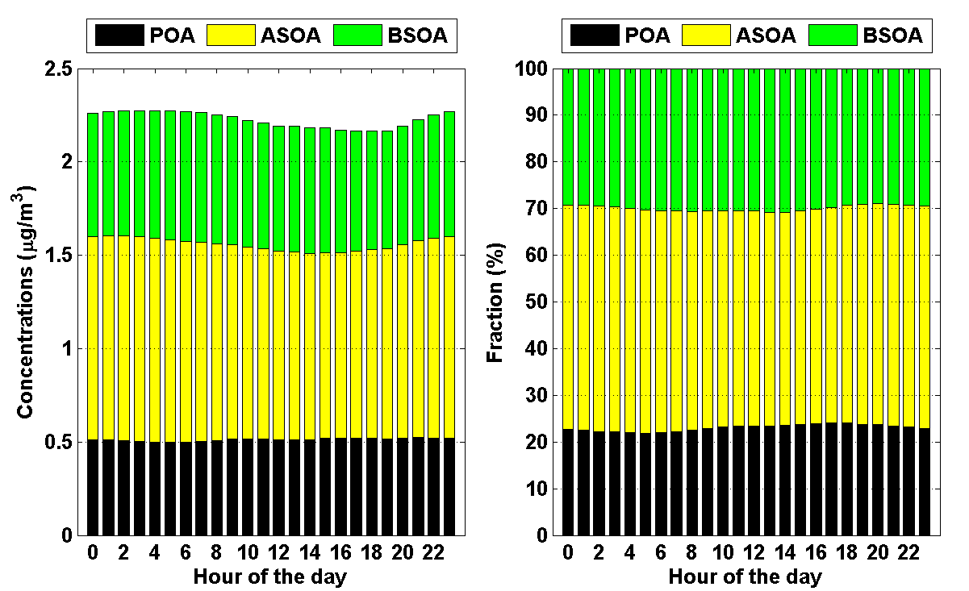
DIURNAL VARIATION OF MODELED OA COMPOSITION AT EMEP STATIONS
Modeled OA composition is nearly constant during all the day.
Simulated SOA/OA: 80%, at the upper end of the 50-80% observed [Jiminez et al., Science, 2009]
Simulated BSOA/SOA: 30% (50-60% in South Europe)

Slide 8
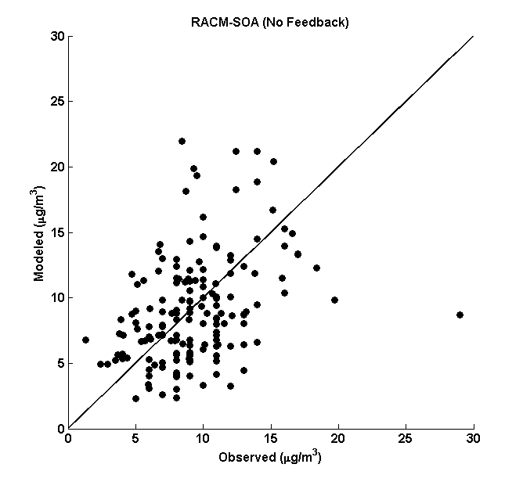
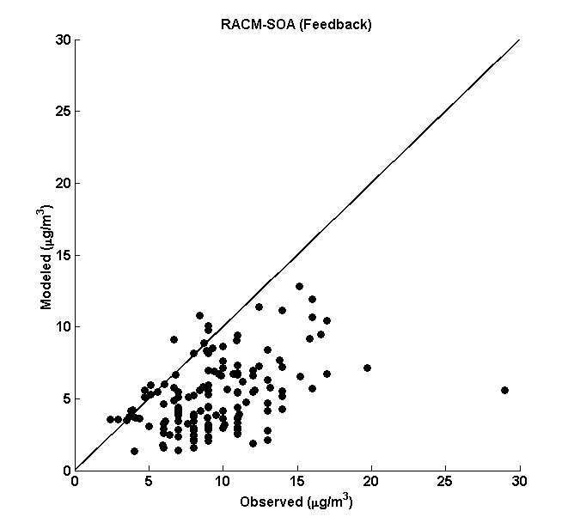
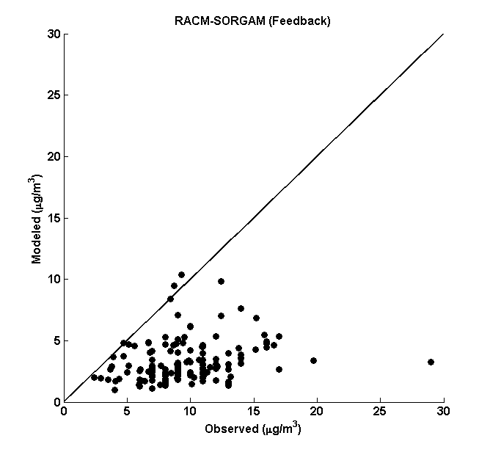
PM2.5: WRF/Chem vs EMEP (10-19 May 2003)
NO FEEDBACK
WITH FEEDBACK
r=0.34
r=0.43
SORGAM WITH FEEDBACK
With direct and indirect aerosol feedback, the simulation of PM2.5 improves.
r=0.20

Slide 9
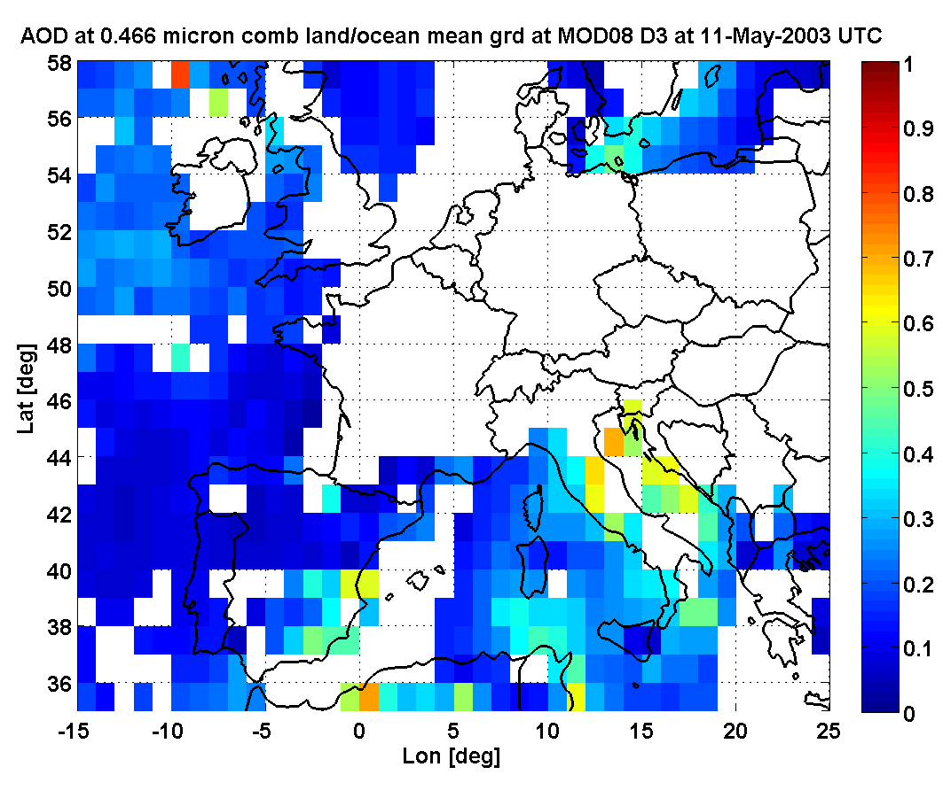
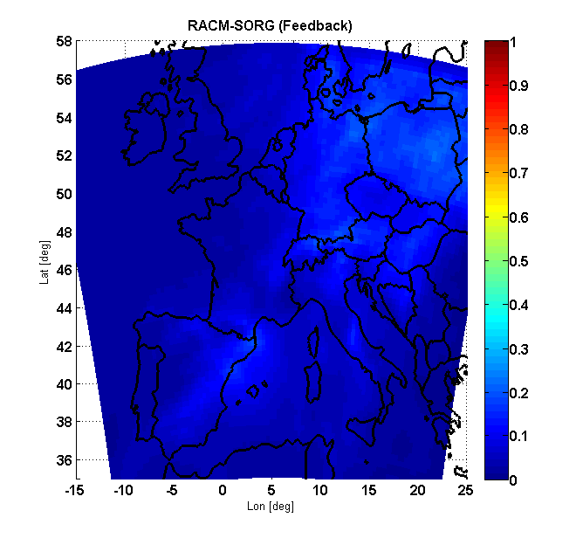
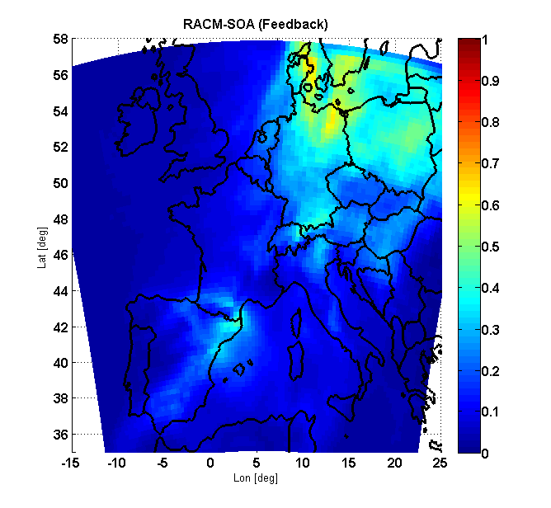
AOT@400 nm: WRF/Chem vs MODIS (11/05/2003)
MODIS
SORGAM with FEEDBACK
NEW SOA with FEEDBACK
New SOA parameterization is able to capture the variability of AOT

Slide 10
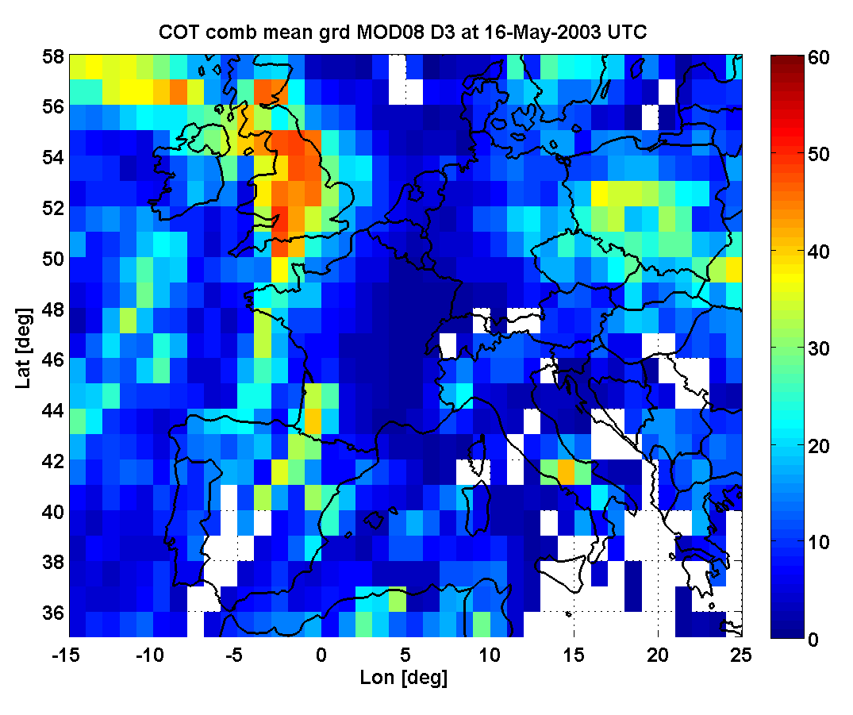
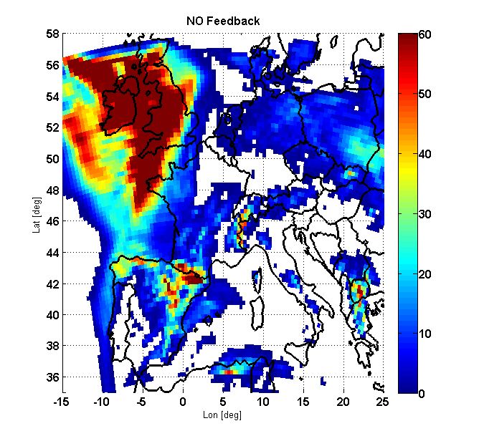
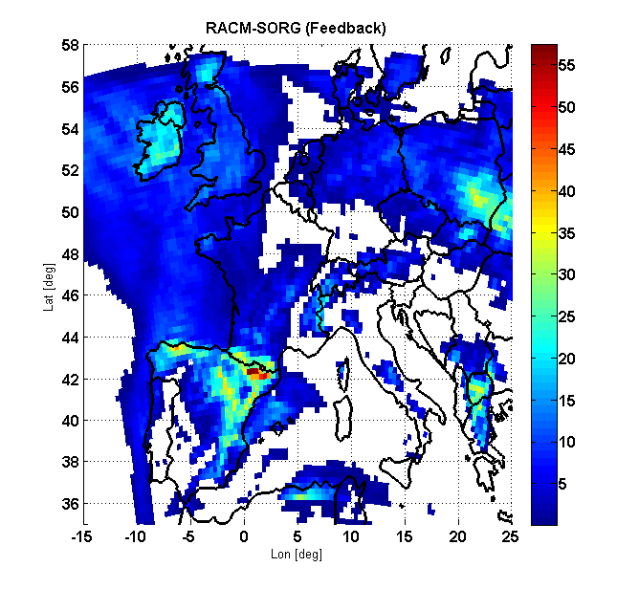
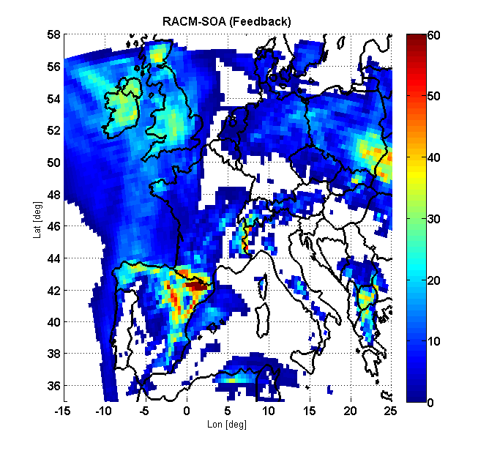
COT: WRF/Chem vs MODIS (16/05/2003)
MODIS
NO FEEDBACK
SORGAM with FEEDBACK
NEW SOA with FEEDBACK

Slide 11
CONCLUSIONS
A new scheme for production of SOA implemented in WRF/chem has been evaluated over Europe.
The carbonaceous aerosols are underestimated.
The new scheme has been coupled with the radiation and microphysics sheme to include the direct and indirect aerosols effects.
Preliminary tests on aerosol radiation-cloud feedback reveal a significant sensitivity of the model to indirect effects. When they are included, the simulations of the PM2.5 mass, aerosol optical depth and cloud optical depth improves.

Slide 12
ANTHROPOGENIC EMISSIONS
Total annual emissions from EMEP:
CO, NH₃, SO₂, NO_{x}, Σ VOC, PM
2. Correspondence among emitted and model species
CO → CO
NOx → NOx
…
PM → 20% PM fine, 80% PM coarse
3. Speciation of Σ VOCs [Passant, 2002]
AGGREGATION
IN 17 WRF/CHEM MODEL SPECIES WITH
REACTIVITY WEIGHTING FACTOR PRINCIPLE
[Middleton et al., Atmo. Env. 1990]
VOC₁
VOC₂
Σ VOC
…
VOC₃₅₀

