Slide 1
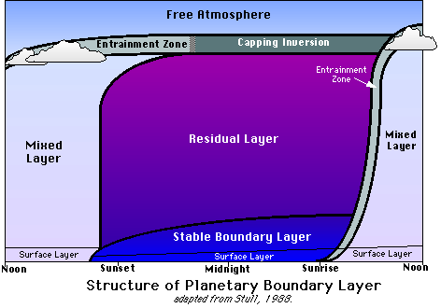




On the interplay between upper and ground levels dynamics and chemistry in determining the surface aerosol budget
Gabriele Curci¹,
L. Ferrero², P. Tuccella¹, F. Angelini³, F. Barnaba⁴, E. Bolzacchini², M. C. Facchini⁵, G. P. Gobbi⁴, T. C. Landi⁵, M. G. Perrone², S. Sangiorgi², P. Stocchi⁵
¹CETEMPS
Dept. Physical and Chemical Sciences
University of L’Aquila
gabriele.curci@aquila.infn.it
² POLARIS Research Centre, Dept. Environmental Sciences, Univ. Milano Bicocca, Milano, Italy
³ Italian National agency for new technologies, Energy and sustainable economic development (ENEA), Rome, Italy
⁴ Institute for Atmospheric and Climate Sciences (ISAC), National Research Council (CNR), Rome, Italy
⁵ Institute for Atmospheric and Climate Sciences (ISAC), National Research Council (CNR), Bologna, Italy
33rd International Technical Meeting on Air Pollution Modelling and its Applications
26-30 August 2013, Miami, FL, USA

Slide 2
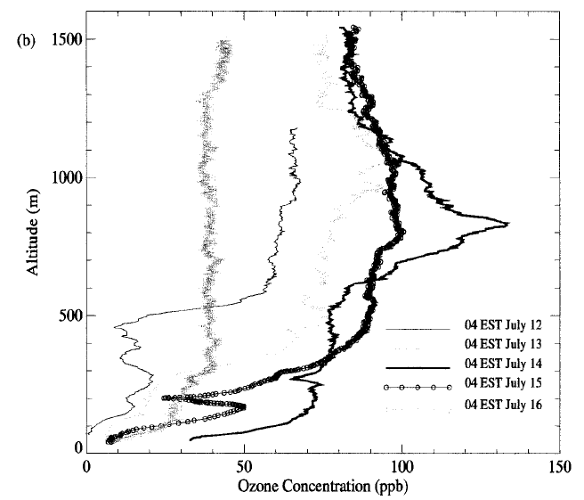
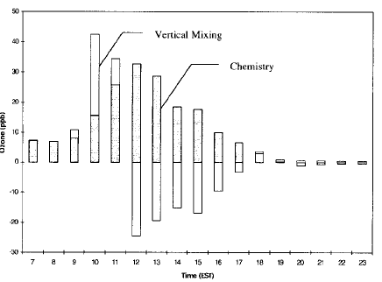
INTERPLAY OF VERTICAL MIXING AND CHEMISTRY
WELL RECOGNIZED FOR OZONE
Nighttime O₃ profiles usually display a residual layer in upper levels
O₃ is brought down by mixing during the morning and may contribute to surface budget as much as chemistry
1500
Vertical Mixing
Chemistry
1000
OZONE (ppb)
ALTITUDE (m)
500
Hour of the day
OZONE (ppb)
[Zhang and Rao, J. Appl. Met. 1999]

Slide 3
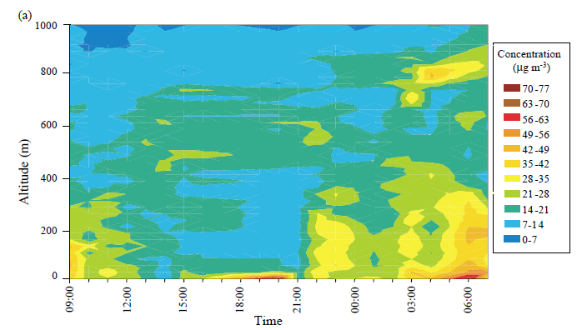
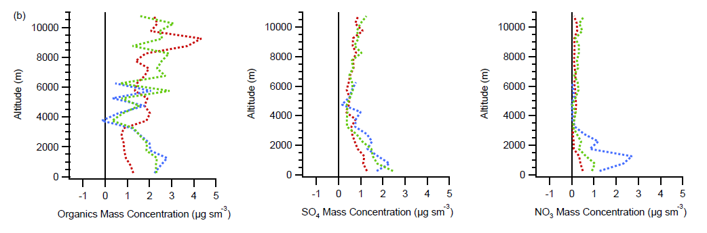
VERTICAL MIXING – CHEMISTRY INTERPLAY IN PBL ALSO IMPORTANT FOR AEROSOL, BUT LESS RECOGNIZED AND QUANTIFIED THAN OZONE
[Maletto et al., Atm. Env. 2003]
A nighttime aerosol residual layer is also often observed,
and may be entrained to the ground the following morning
[Morgan et al., ACP 2009]
Aircraft measurements reveal different profiles for PM species in the PBL
Upper level peak of nitrate
ALTITUDE (m)
ORGANICS (µg/m³)
SULFATE (µg/m³)
NITRATE (µg/m³)

Slide 4
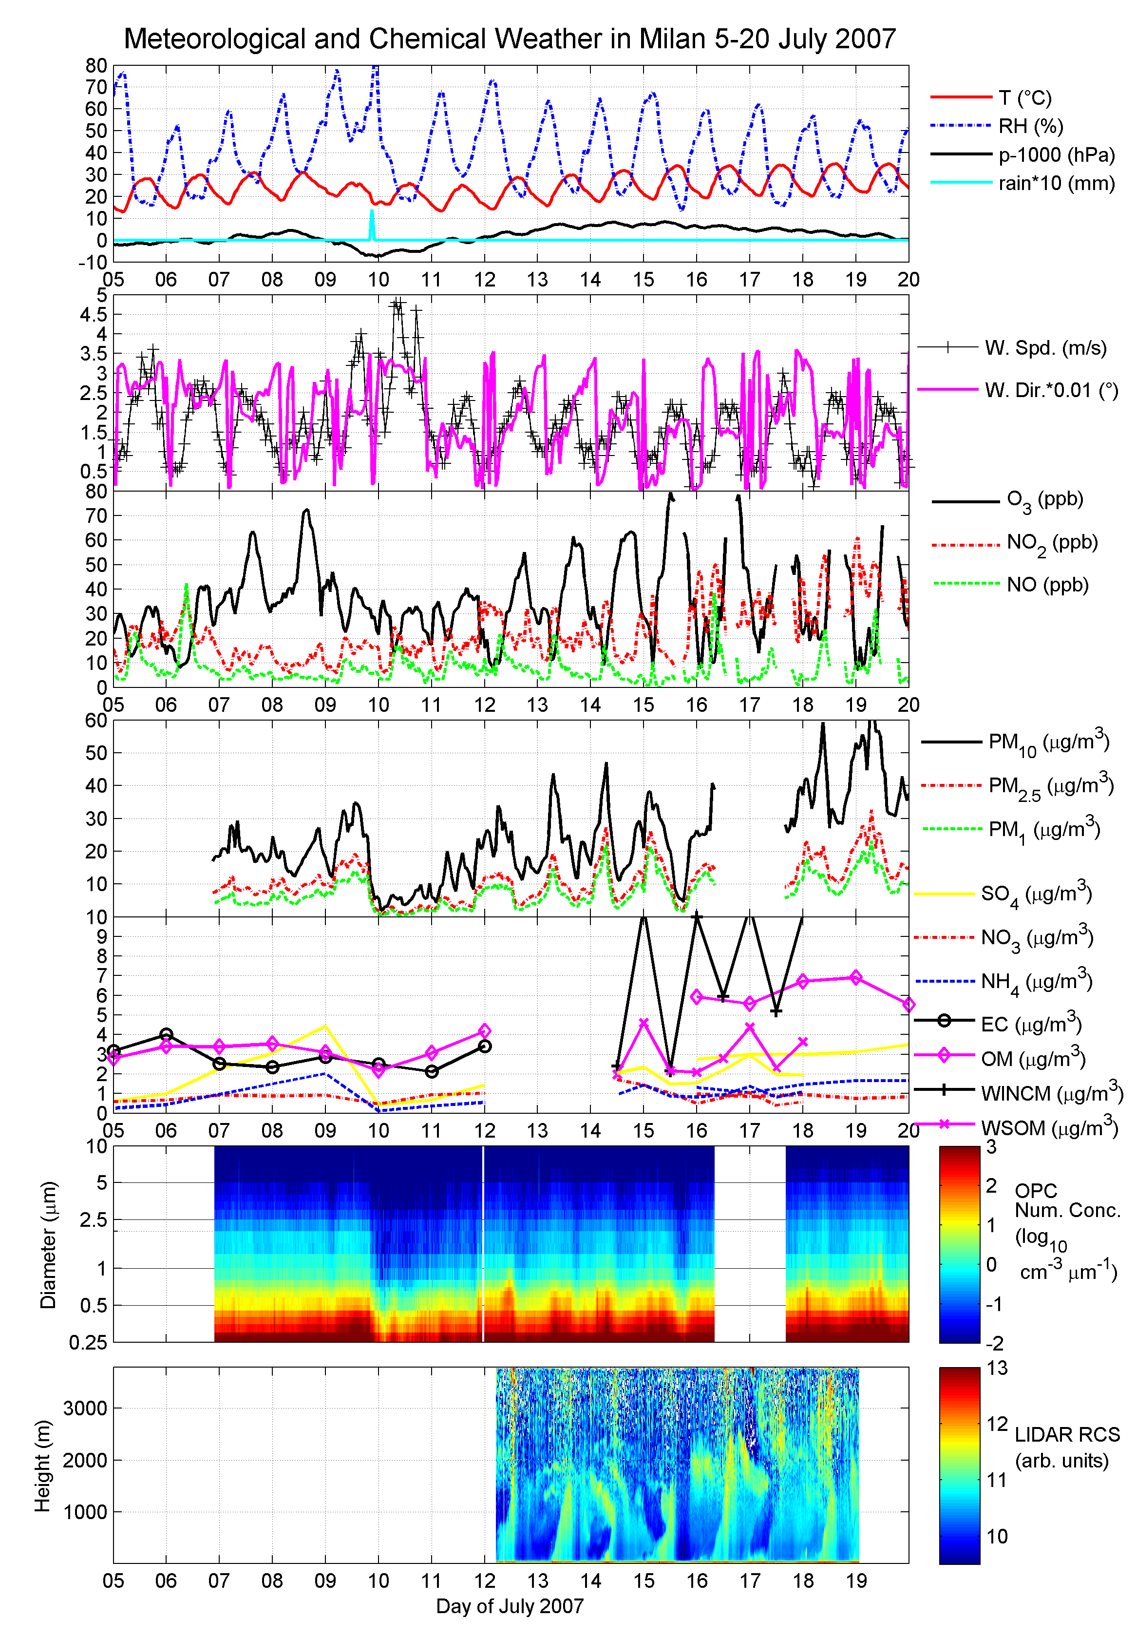
CASE STUDY: 5-20 JULY 2007, INTENSIVE CAMPAIGN IN MILAN (ITALY)
Passage of Atlantic perturbation 9-10 July
High pressure
Mountain-Valley breeze under high pressure

Slide 5
CHEMISTRY “RESTART” AND AEROSOL LAYERING
Wet processes efficiently remove aerosol during 9-10 July.
PM
Then aerosol builds-up under high pressure
OPC
LIDAR
Aerosol residual layers, mixing down
Afternoon cleansing of lower levels by mountain wind

Slide 6
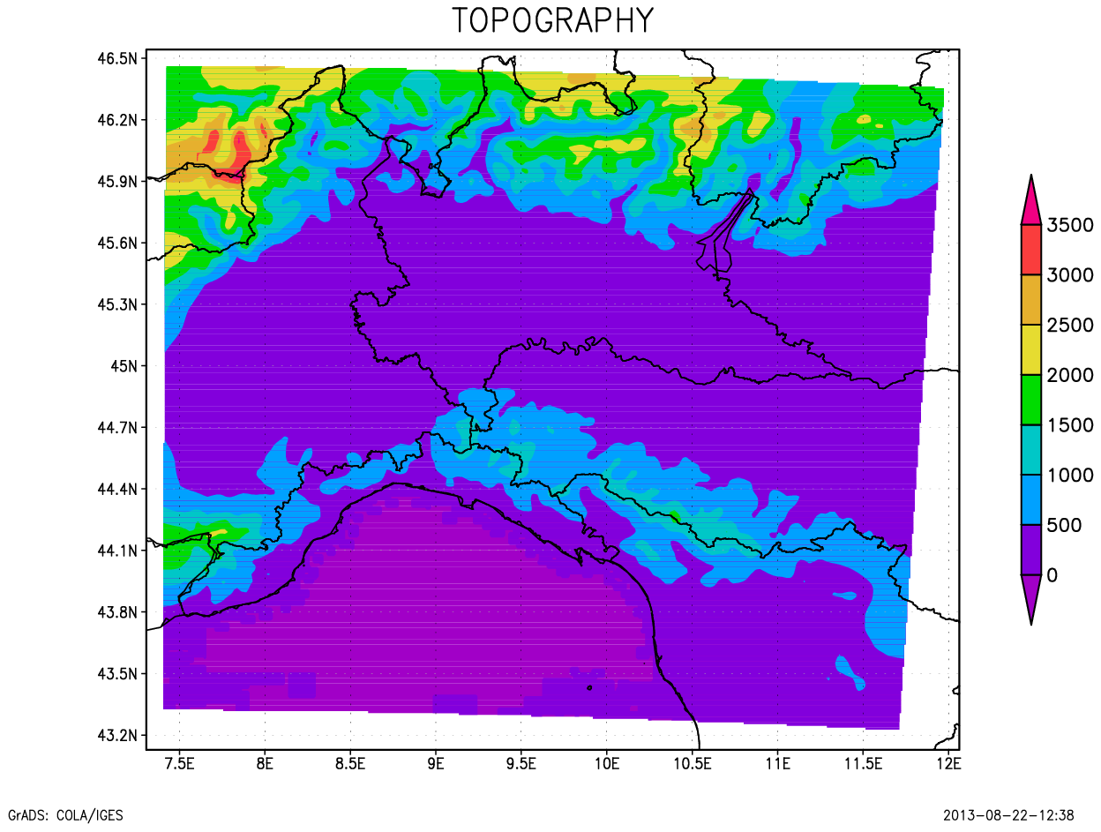
WRF/Chem MODEL RUN AT 2 KM AROUND MILAN
PROCESS | WRF/Chem OPTION
Cloud Microphysics | Morrison
Long-wave Radiation | RRTMG
Short-wave Radiation | RRTMG
Land Surface Model | Noah
Surface Layer | Monin-Obukov
Boundary Layer | MYNN2
Photolysis | Madronich
Gas Chemistry | RACM
Aerosol Scheme | MADE / VBS
Aerosol Direct and Indirect Eff. | No
Urban Canopy Model | No
Period simulated
25/6 - 20/7 2007
first 10 days spin-up
MILAN

Slide 7
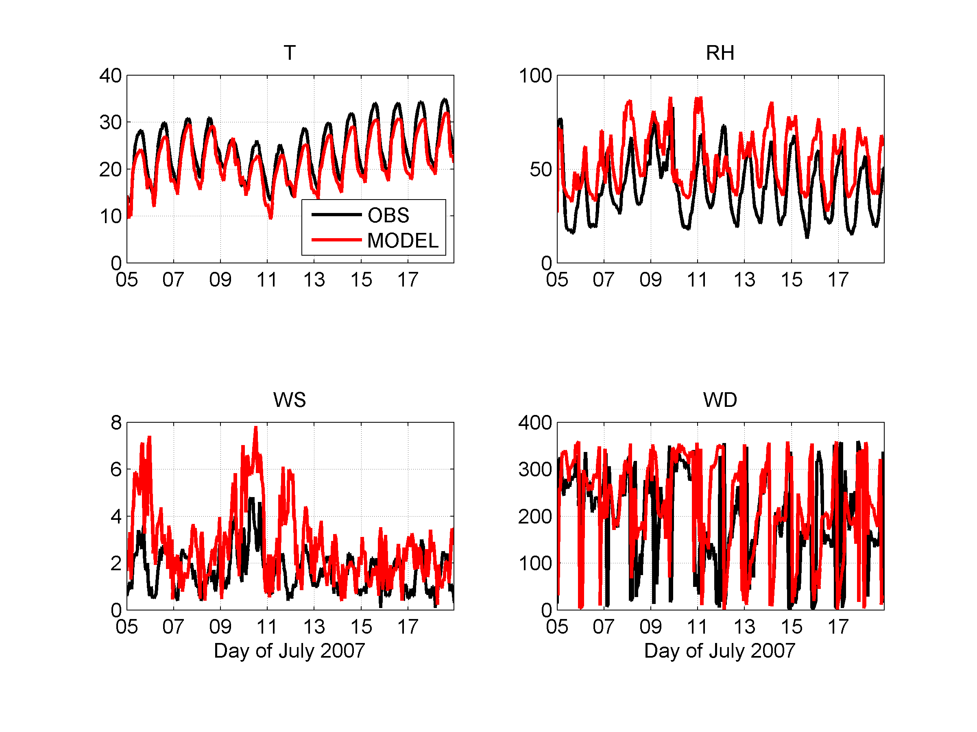
MODEL VERIFICATION: METEOROLOGY
Low temperature bias (-2.5 K)
High wind speed bias
(+40%)
Wind direction ok

Slide 8
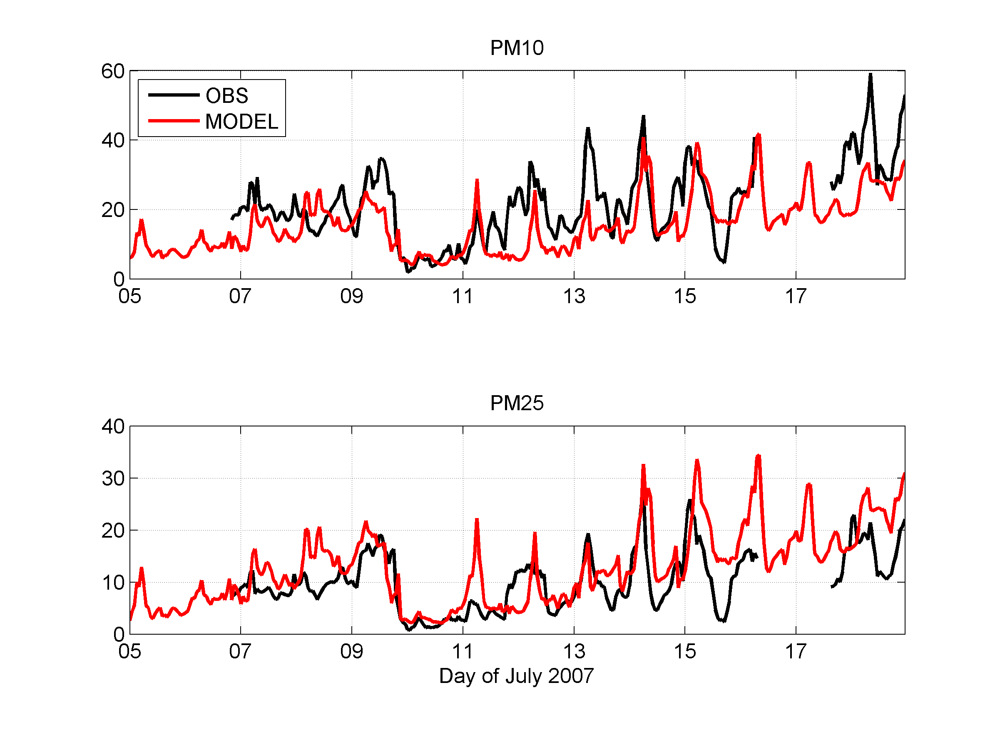
MODEL VERIFICATION: AEROSOL MASS
Low PM10 bias (-35%)
Good simulation of removal
High PM2.5 bias (+15%)

Slide 9
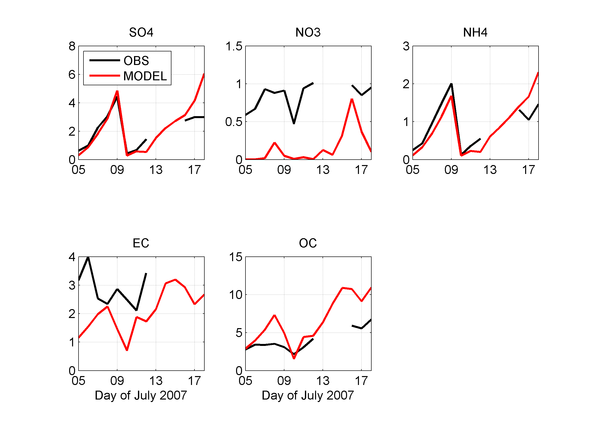
MODEL VERIFICATION: AEROSOL COMPOSITION
Large underestimation of nitrate
Organics overestimated

Slide 10
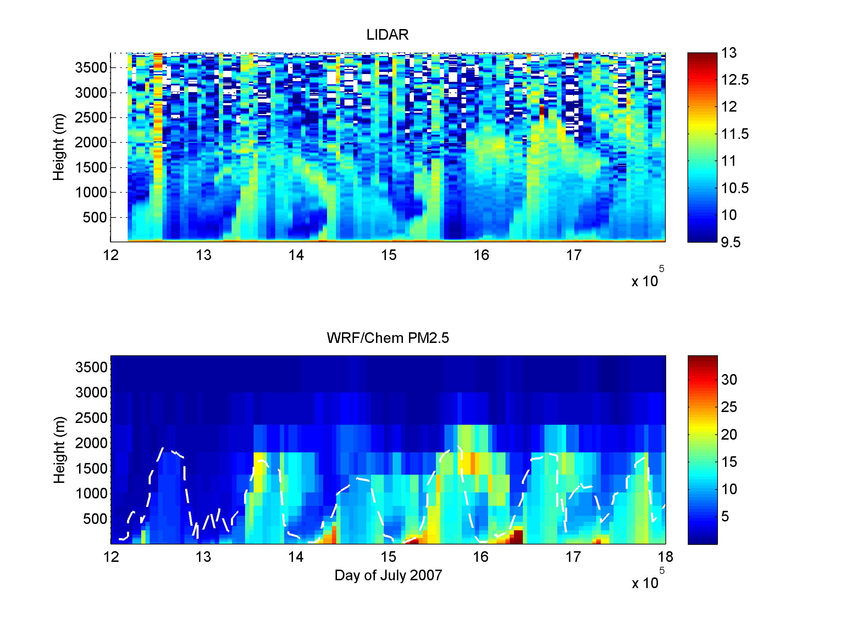
AEROSOL PROFILE: LIDAR vs MODEL PM2.5
Saharan dust
LIDAR
Enhanced upper aerosol layers
WRF/Chem PM2.5

Slide 11
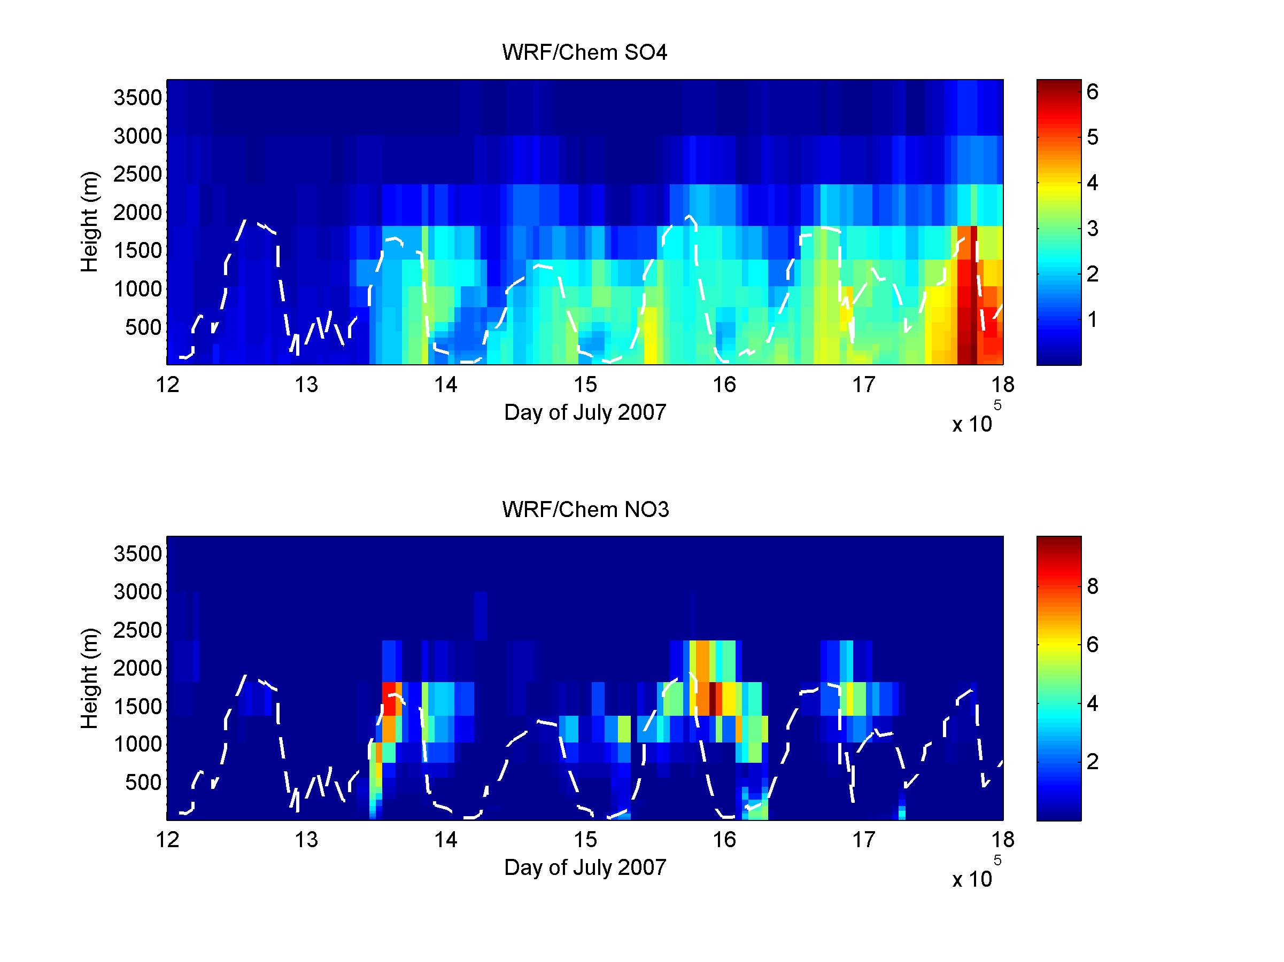
AEROSOL PROFILE: COMPOSITION
SULFATE
Enhanced upper aerosol layers:
mostly nitrate (low temperatures)
NITRATE

Slide 12
WRF/Chem NEW CHEMICAL BUDGET DIAGNOSTIC
Diagnostic for gases implemented in V3.4 by Wong et al. (manuscript in prep.)
Extended to aerosol processes in this work
Simple strategy:
save 3D changes in species concentration after a given process:
chem_old( i,j,k,spec ) = chem( i,j,k,spec )
call integrate_process_x
process_x_tendency( i,j,k,spec ) =
process_x_tendency( i,j,k,spec ) +
chem( i,j,k,spec ) - chem_old( i,j,k,spec )
CHEM = Photochemical production + aerosol processes
VMIX = Vertical turbulent mixing + dry deposition

Slide 13
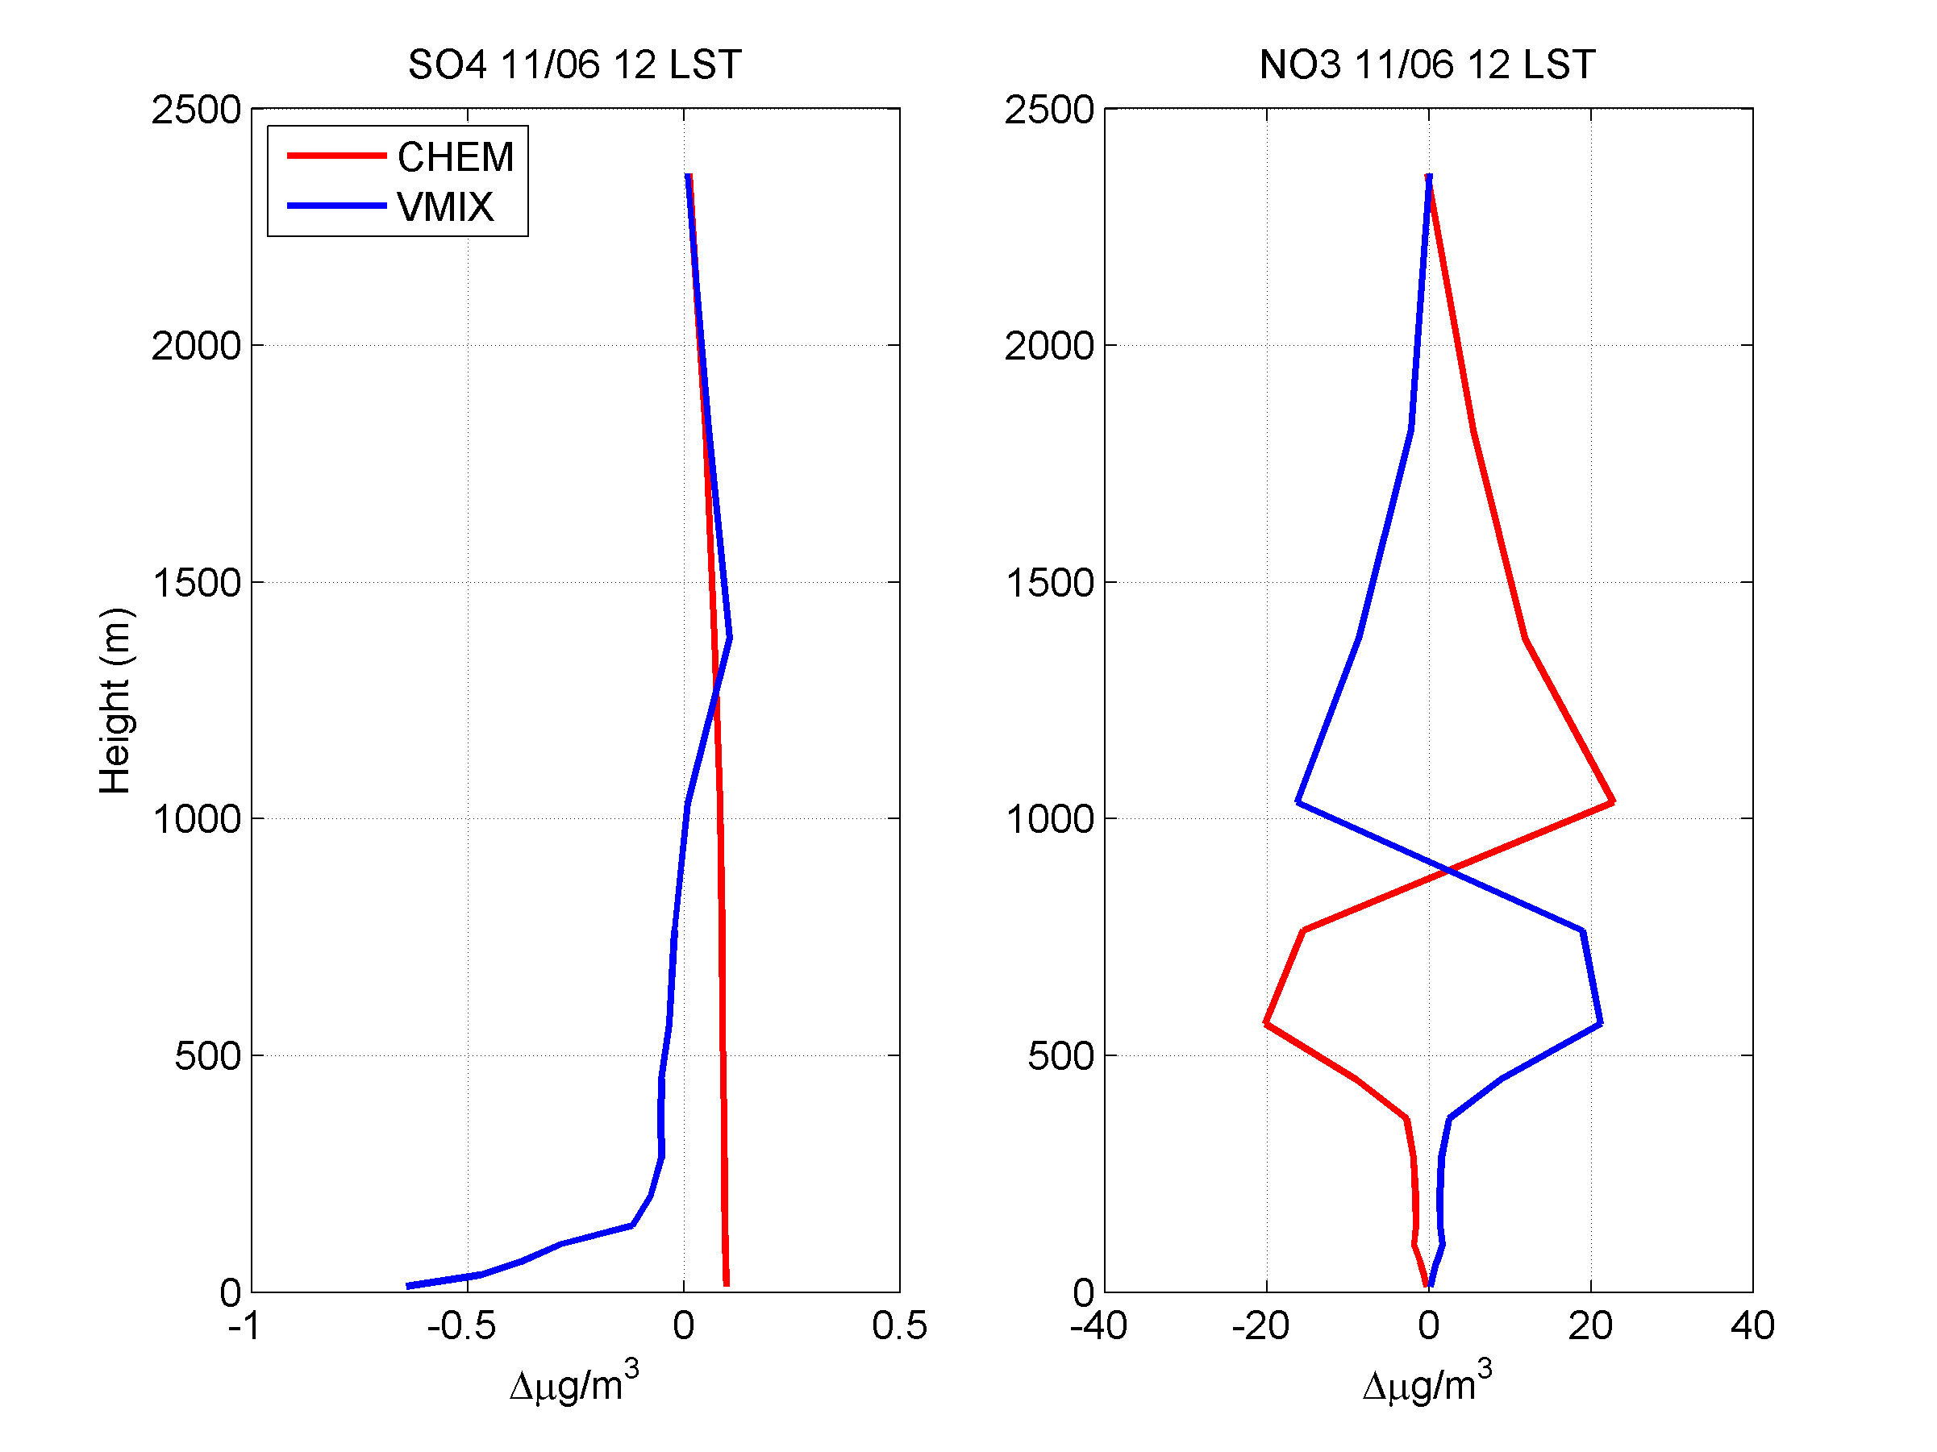
SULFATE AND NITRATE BUDGET
SULFATE
NITRATE
Production up in the PBL, destruction down
Production through PBL
Net production nearly in local equilibrium with vertical mixing
downward transport
Upward transport
Dry Dep

Slide 14
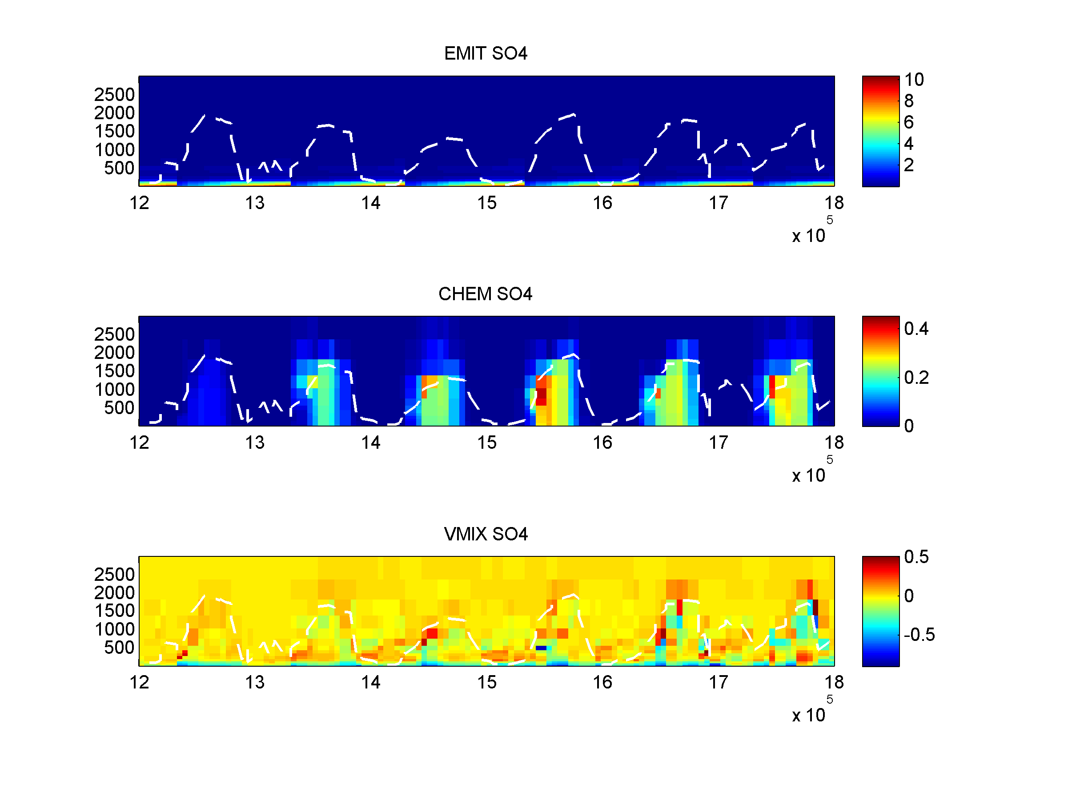
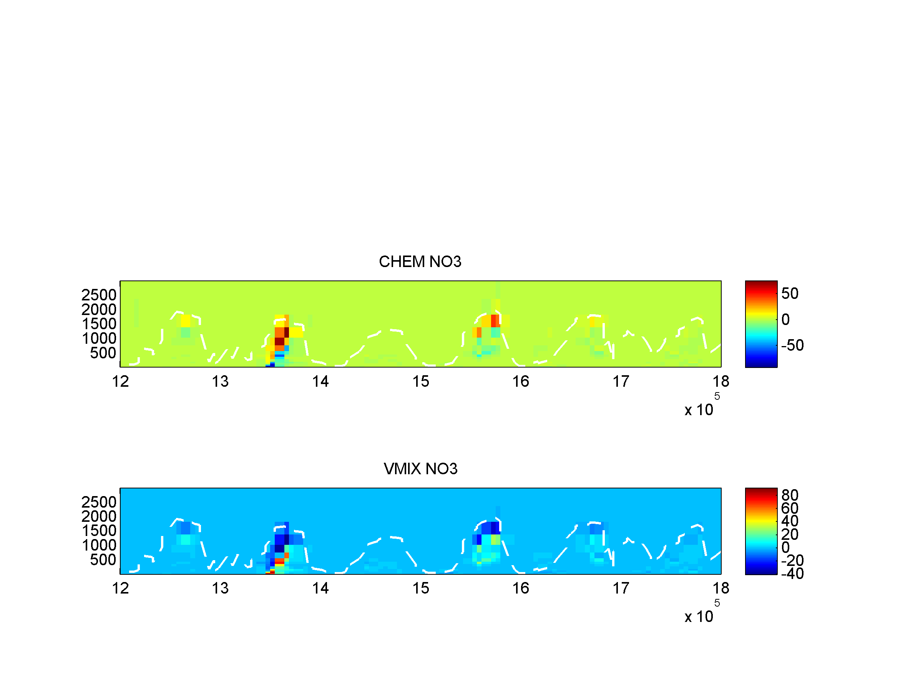
SULFATE AND NITRATE BUDGET
Emissions in bottom levels
NITRATE
SULFATE
Chemical production in upper PBL, destruction in bottom PBL
Chemical production through PBL
ALTITUDE (m)
Dry deposition in bottom levels,
mixing through and out of PBL
Turbulence mixes down nitrate produced up in the PBL

Slide 15
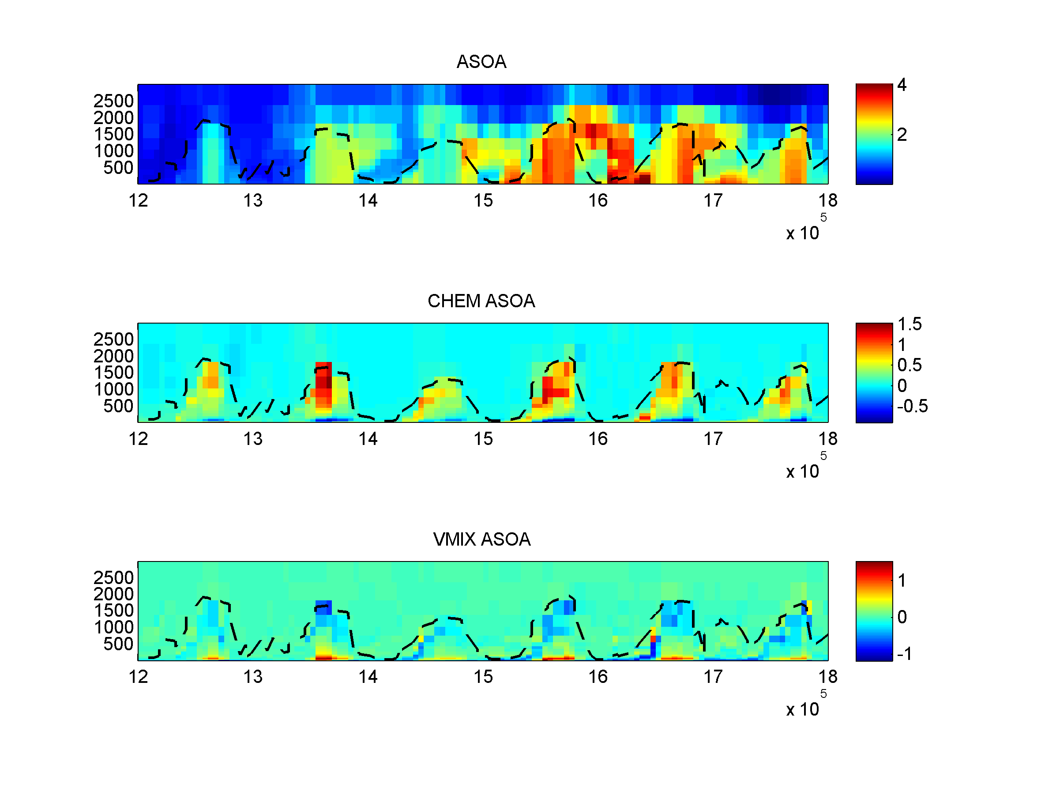
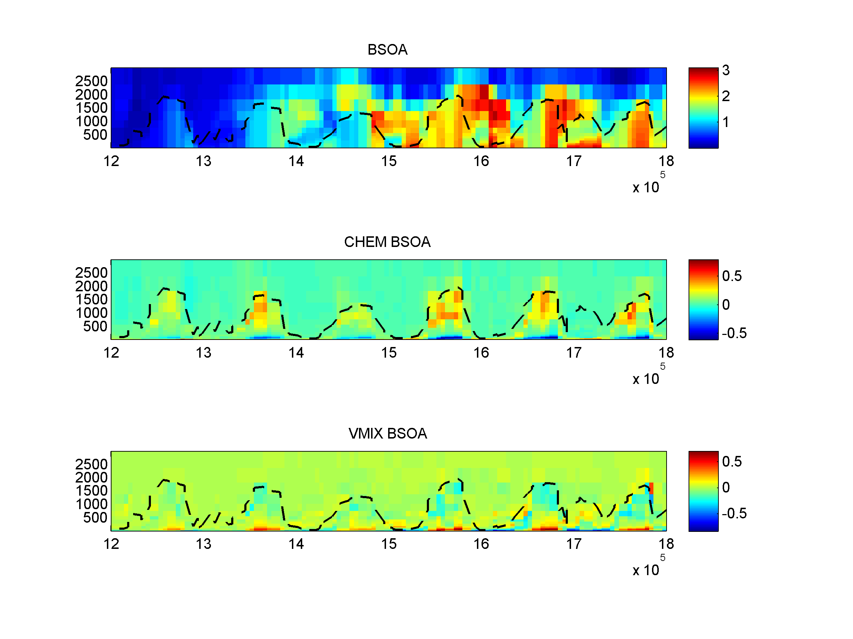
SECONDARY ORGANIC AEROSOL BUDGET
Anthropogenic SOA
Biogenic SOA
Intermediate behavior between sulfate and nitrate
ALTITUDE (m)

Slide 16
CONCLUSIONS AND OUTLOOK
An interesting case study in summer, high pressure condition was identified, with a chemical “restart” and aerosol layering
Model suggests that upper aerosol layer is mostly made of nitrate and SOA, which is produced locally (low temperatures)
Nitrate chemical production is almost in equilibrium with vertical mixing, possibly indicating a too fast convergence toward thermodynamic equilibrium of the inorganic phase → sensitivity tests on thermodynamic equilibriium timescales
To explain the model low nitrate and SOA bias at the ground it is key to check processes up in the boundary layer → sensitivity tests switching off chemical processes in selected layers

Slide 17
THANKS FOR LISTENING!

